Slide 1
Congratulations on your purchase of the Wild Wing!
This booklet will guide you through the assembly and you will be out flying your new wing in no time!

Slide 2
What you will need to complete this kit:
Plastic hinges, ½” x 1” (6 needed)
Control Horn, ½” (2 needed)
Medium CA
Thin CA
Epoxy (20 Minute)
36” ruler
3 Rubber bands
Flat Building surface
Building saw
Square
1 Roll of Covering (your choice on colors and Brands, I like to use more than one color and UltraCote Brand)
Suggested motor: Propdrive2826 1350 KV
Speed Control: 30 amp
Prop 9 x 4.7
Battery: 3 cell 1000 MaH
2 -Small round magnets (these will hold the hatch in place)

Slide 3
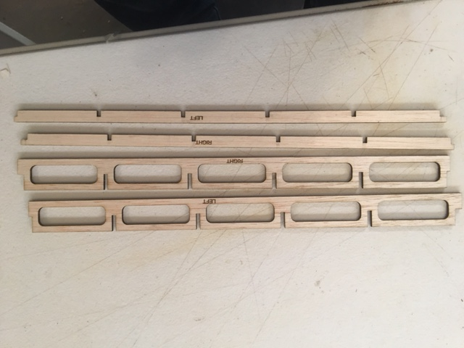
First thing we need to do is organize all the parts to make sure you have everything.
Inventory
I will go through each part and explain what they are and any special direction they might need to go during assembly.
A. Spars,
There are four spars total, two front (larger) and two back (narrower). They are marked Left and Right. You also need to be aware that they each have a larger step on one end. This is very important later in the build.

Slide 4
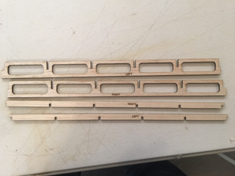
Each spar has one end that has a ¼” step, the other end only has an 1/8” step.
¼” step on this
end
1/8 step on this end

Slide 5
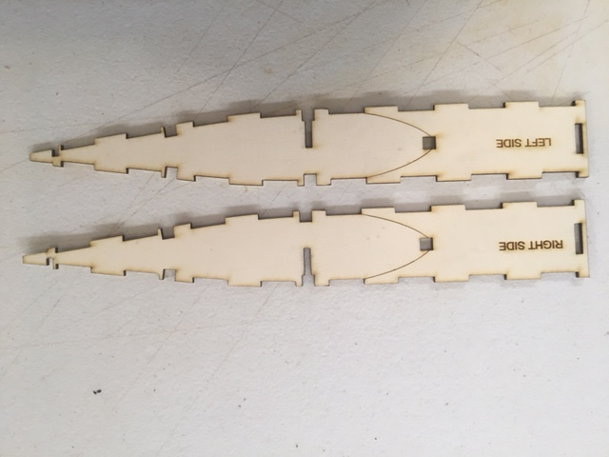
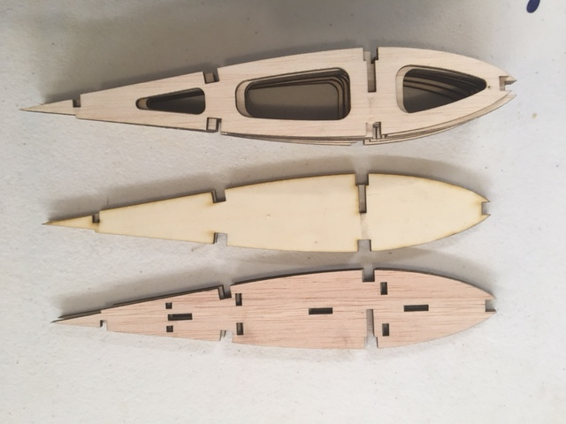
B. Box Sides, There is one right and one left Box Side, they are marked Left and Right.
C. Ribs, There are three different types of Ribs: 1/8” Balsa (8 pcs), 1/8” Ply (2 pcs) and 1/8” balsa End Caps (2 pcs)
The ribs W2- W5 are not marked it isn’t needed.
End Caps, 1/8” Balsa
1/8” Ply W1
1/8” Balsa W2-W5

Slide 6
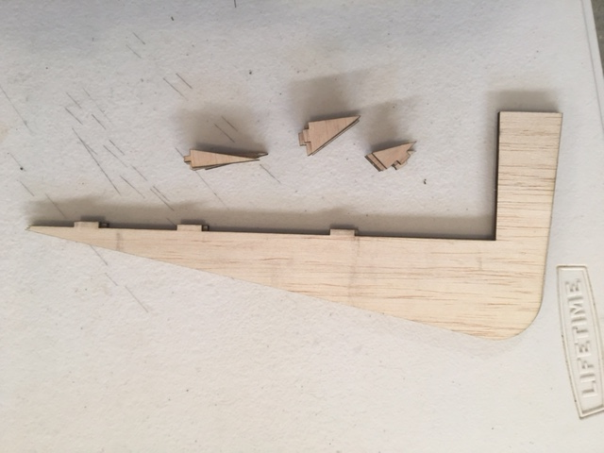
D. Wing Tip, There are two of these one mounts on each end of the wing, along with these there are 12 Triangle pieces.
These triangle pieces keep the wing tip straight on the end of the wing and make it more stable. Each triangle piece fits into a slot in the End Cap Rib.
End Cap Rib
Locating Slots for triangles

Slide 7
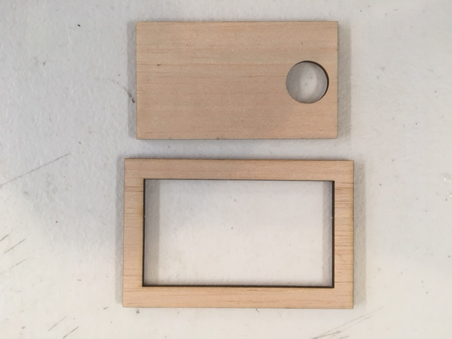
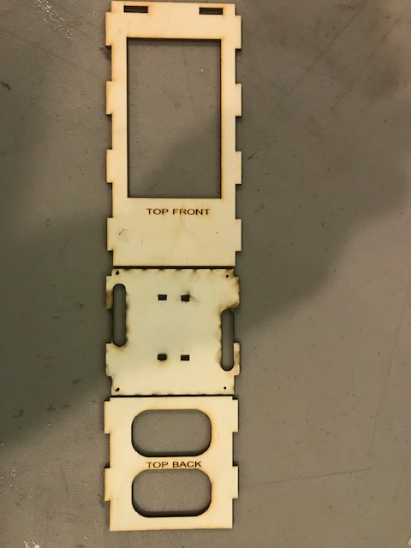
E. Hatch and Doubler
F. Top of Box pieces (3 total)
These three pieces are marked “Top Front”, “Servo Hatch” and “Top Back”

Slide 8
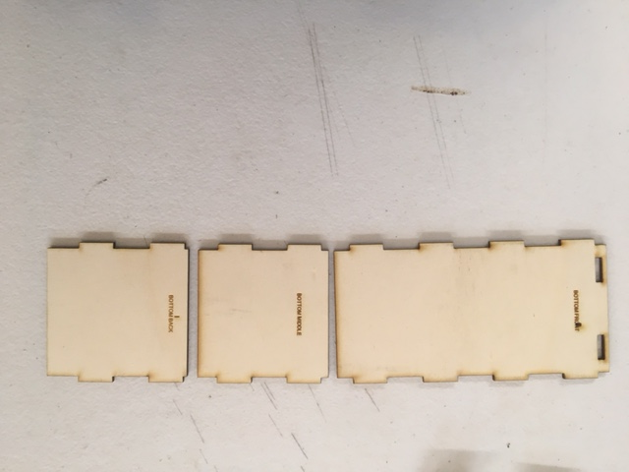
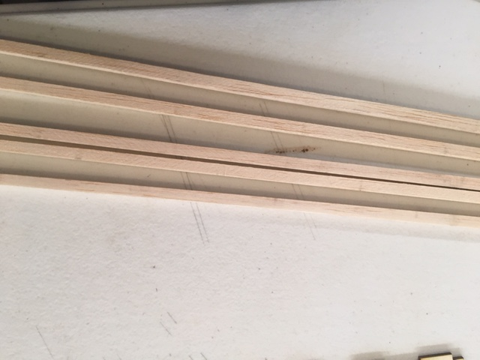
G. Bottom Box Pieces,
Same as the top pieces there are three of these as well, again all marked Front, Middle and Back.
We have changed the design of these three pieces to lighten the wing, your pieces will have cut outs in them.
H. ¼” x ¼” Balsa sticks (5 total)
These all need to be cut to different lengths.

Slide 9
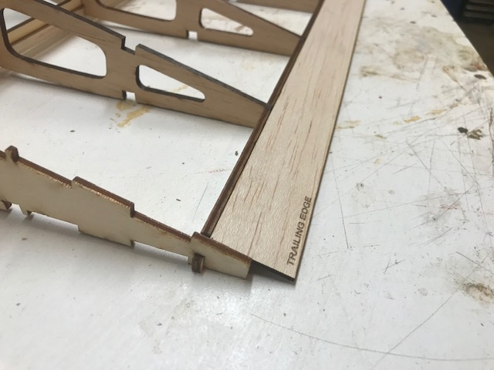
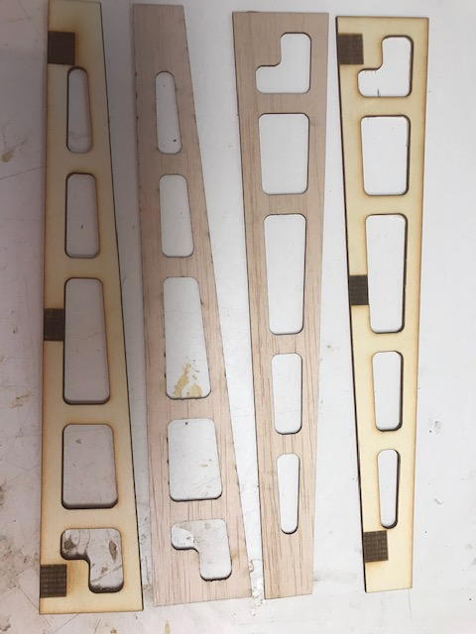
I. Trailing Edges 1/16” x 1-1/2 x 36” balsa (2pcs)
J. Ailerons
There are 4 of these strips
There are 2 ply pieces and 2 1/16 balsa pieces

Slide 10
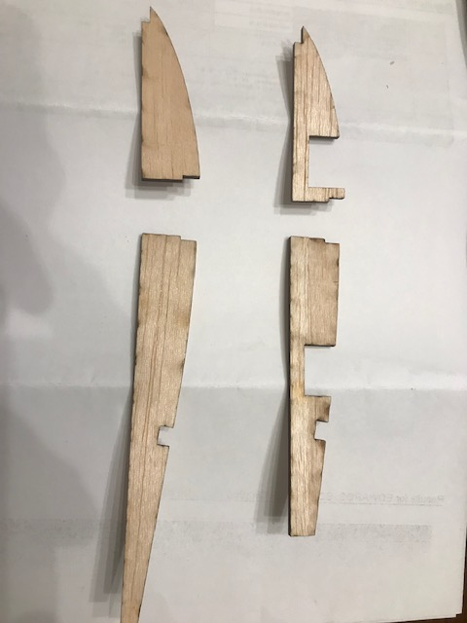
Vertical Stab doublers
There are two sets of these
Parts. They are called Vertical
Stab doublers.
We will be using these in
Step 4.
They mount on the second rib
From the center on both sides of
The wing. They are glued to the rib.

Slide 11
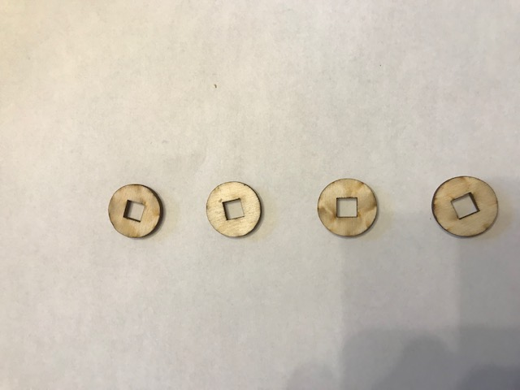
Balsa caps
These mount inside the
Fusebox on the ends of
The ¼ x 1/4balsa to hold
the sticks from sliding
Out.

Slide 12
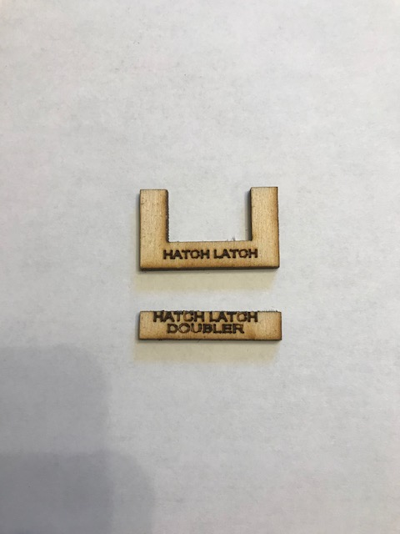
Hatch Latch and Doubler
We will be gluing these to the
Hatch later on

Slide 13
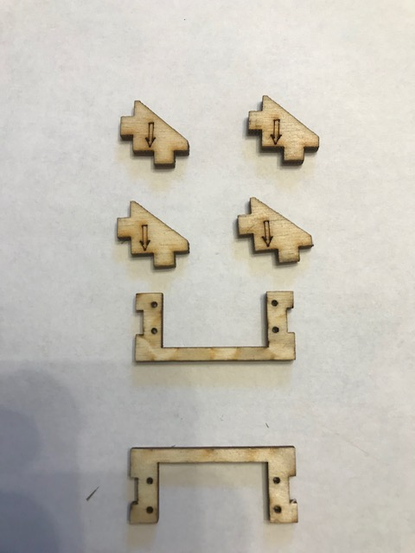
Servo Holders
These mount on the bottom
of the servo hatch

Slide 14
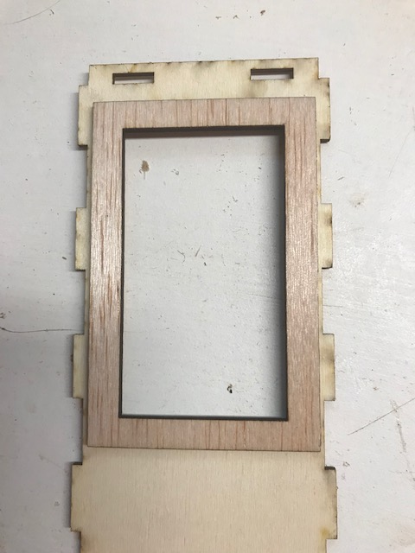
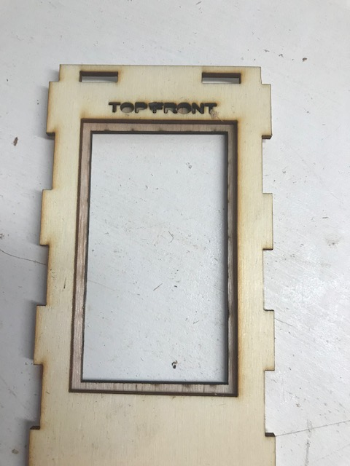
2 Assembly
Find the pieces marked “Top Front” and Hatch Doubler.
Use Medium CA and place a drop of CA about every ¾” around the Hatch Doubler.
Now carefully line up the “Top Front” on top of the Hatch Doubler so there is an even amount showing on all sides. Press down for 15 seconds

Slide 15
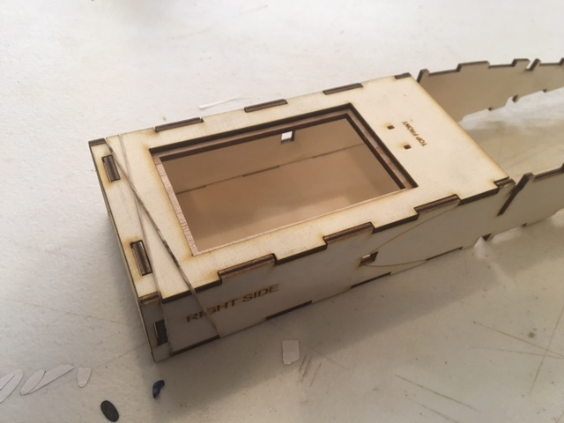
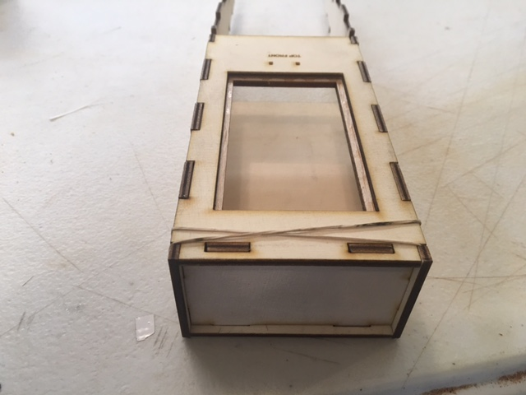
Assemble the Fuselage Box
Step 1. Let the doubler CA dry for a few minutes then locate the “Bottom front” of the box along with the “Box sides”
and “Firewall”
Once you dry fit everything, you can use the Medium CA and glue the Fuselage box together. I use the rubber
Bands in place while the glue dries.

Slide 16
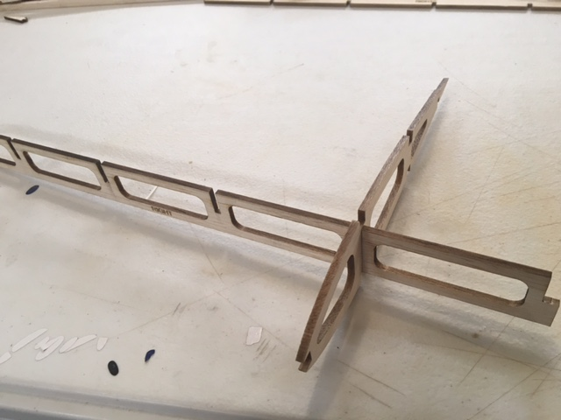
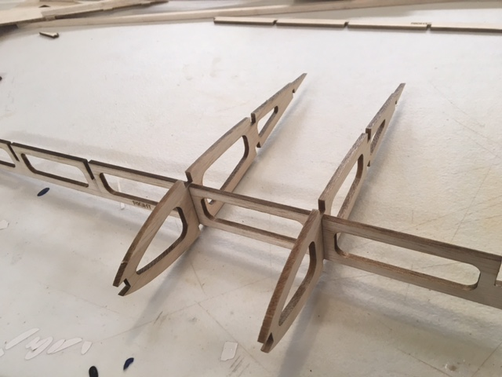
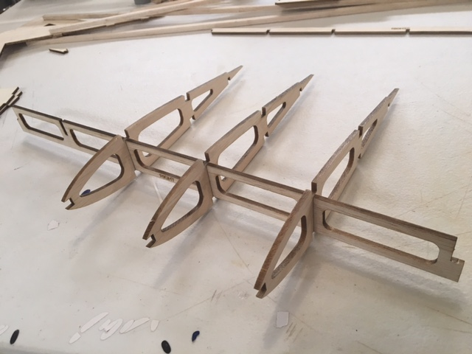
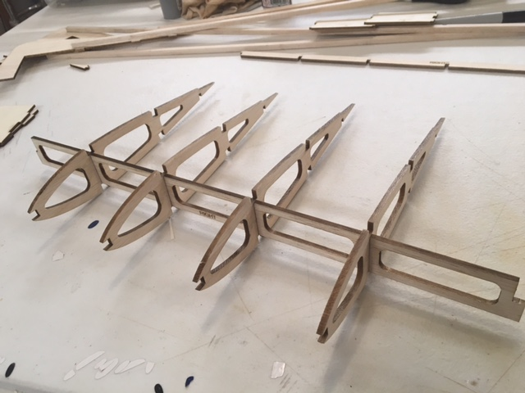
Step 2, Put the Box assembly aside for now and find the Front and back Spars as well as the 1/8” Balsa wing ribs.
Again, using no glue, start by sliding a wing rib in the first full slot of the large spar, as shown, do not force the rib into the slot, it’s tight but it will slide in the slot with gentle but steady pressure.
Please note, the rib goes into the FIRST FULL slot in the spar
Repeat this step for the 3rd , 4th and 5th rib

Slide 17
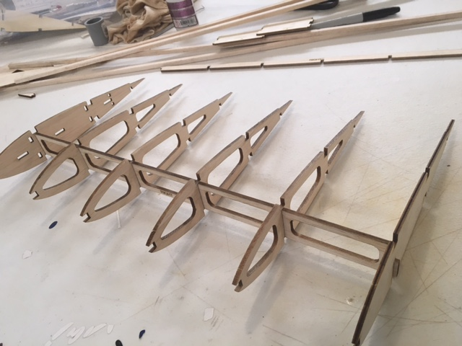
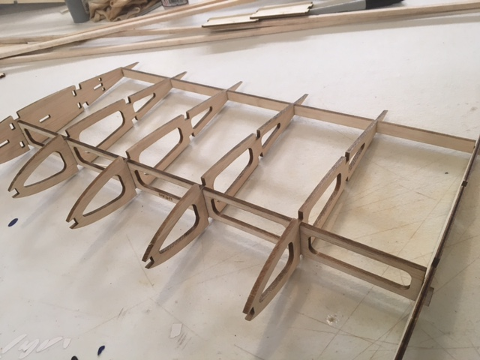
Locate one End Cap and one 1/8” Ply rib and insert them on each end of the wing panel, as shown
Please note, the 1/8” Ply Rib is located on the end that has the ¼” step on the spar as shown on page 3. Make sure the Spar sticks out through the 1/8” Ply Rib 1/8”
Locate the smaller spar and GENTLY insert the Spar in the slots to the rear of each rib. Start at one end and take
your time sliding the spar in as far as it will go. Your assembly should look like this after you’re done .
Now repeat step 2 again to make the other side of the wing.

Slide 18
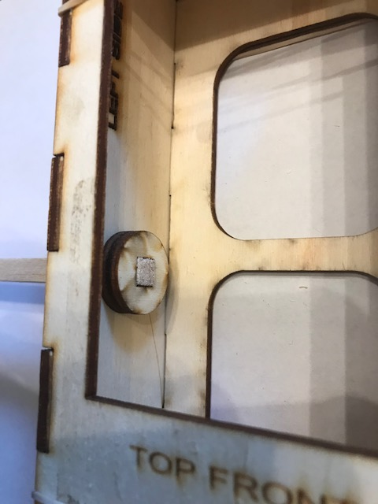
Step 3, Find one of the ¼” x ¼” Balsa sticks, Cut one stick into 2 16-1/8” long pieces. With the fuse box in front of you push the sticks into each side of the box until approx. ¼” stick out on the inside of the box. Now find the round ply parts with the square hole in them. Two of them go onto each side 1/4x ¼ balsa stick.
DO NOT GLUE YET
Step 4, Now it’s time to join the Fuselage Box and the wing halves.
Lay the Box in front of you so the front of the box is facing you and bring one of the wing halves up and begin
Putting the ¼” x ¼” stick in the slot in the front of each rib. Once you have all five ribs connected to the ¼” x ¼”
Stick, make sure the 1/8” Ply rib is resting right next to the box side.
Repeat this step for the other side of the wing.

Slide 19
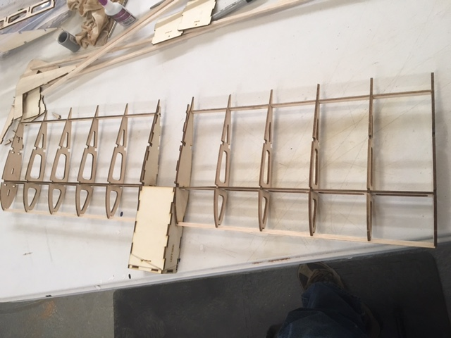
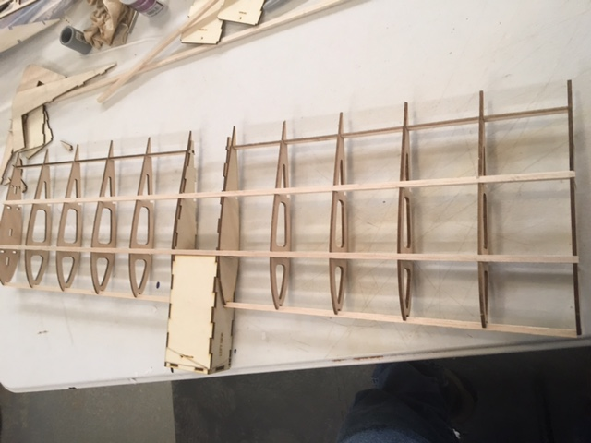
Step 3, Now that the Box and both wing halves are together, find two more of the ¼” x ¼” stick and slide them into the ¼” slots along the top of the wing.
This picture shows the ¼” x ¼” sticks in place on the top of the wing.
After the ¼ x ¼ sticks are in place, check the squareness of the wing to make sure everything is straight
When you’re happy with the fit, open the THIN CA and glue every joint. Then let the plane sit and dry.

Slide 20
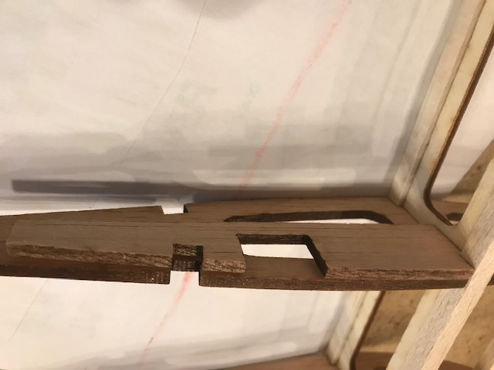
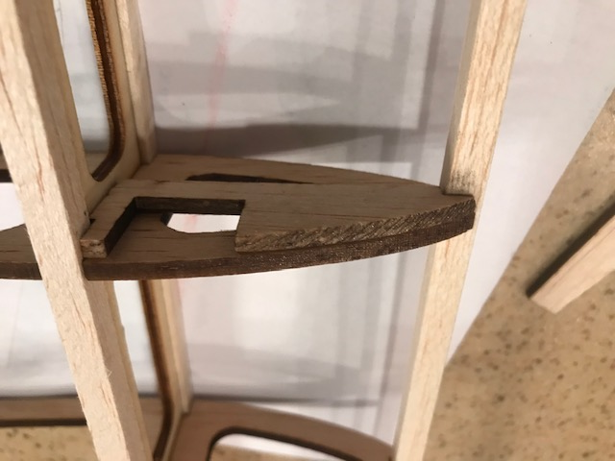
Step 4, Installing the doublers for the vertical fins
Locate the 2 parts that look the back of a wing rib and they will be glued to the
INSIDE of the 2nd rib on each side from the center, as shown
Locate the front 2 parts that look like the front of a wing rib and glue them to the
2nd rib from each side from the center, as shown.

Slide 21
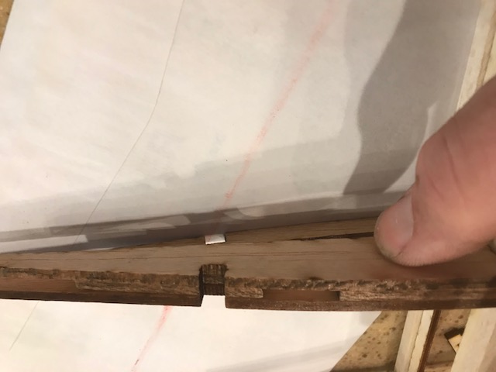

When the first doublers are glued in place locate the next two pieces that will locate right beside the first pieces. See pictures for clarity
As you see here, the doublers will form a pocket
In which the vertical stab tabs will slide into.

Slide 22
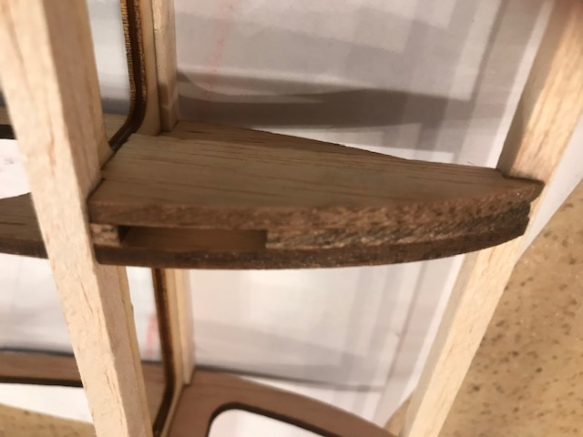
Repeat the process for the front doublers
The second doubler will also form a pocket for the front tab of
The vertical stab to mount in

Slide 23
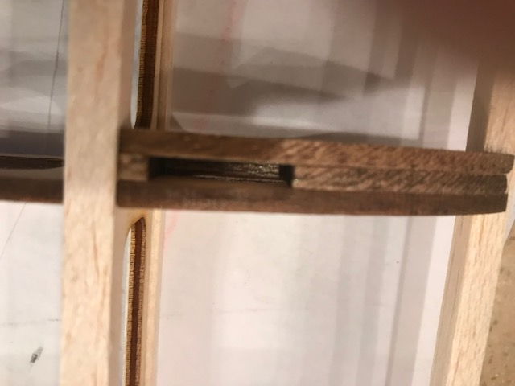
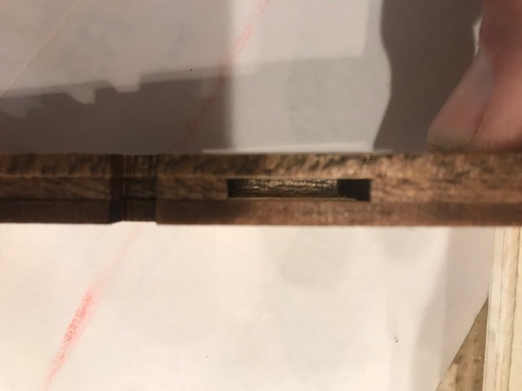
This shows the front and back doublers in place ready to accept the vertical stab

Slide 24
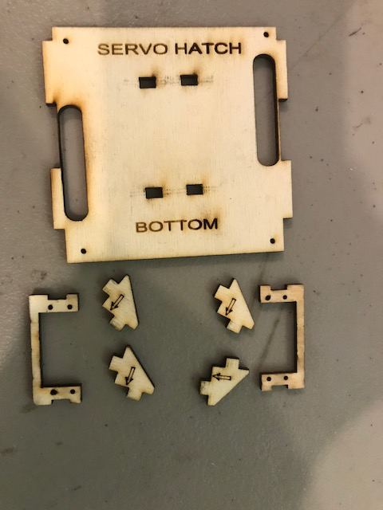
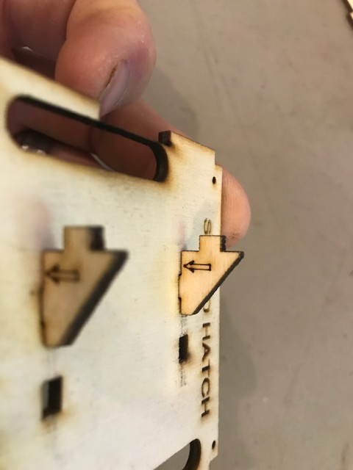
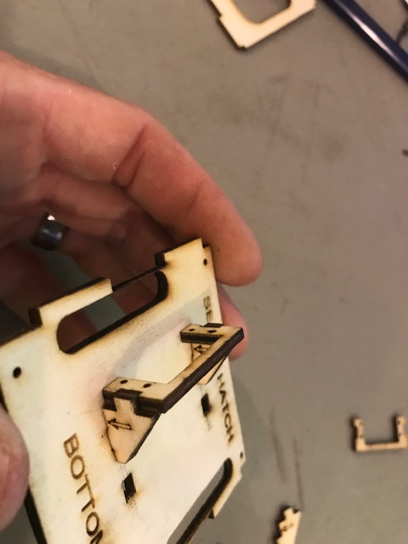
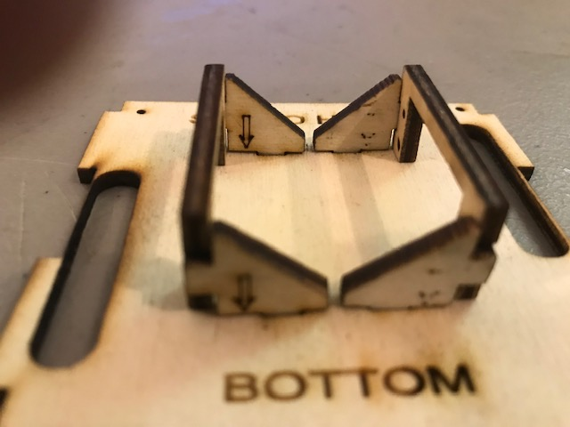
Servo Hatch
Locate the servo hatch and the servo holders, as shown in the picture.
Make sure you assemble the servo holders on the BOTTOM of the servo hatch.
The bottom is marked as bottom ( Bottom side will mount inside the fuselage)
Assemble the servo holders and glue in place as shown.
Also please note the arrows, they face down toward the servo hatch

Slide 25
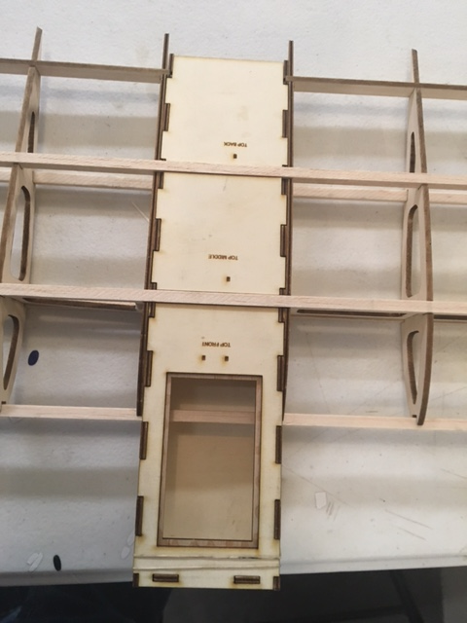
Step 5, Find the “Servo Hatch” and “Top Back” pieces, Glue the “Top Back” with CA as shown.
DO NOT glue the servo hatch down, you will be using the 4 screws
provided to secure the servo hatch in place later on.

Slide 26
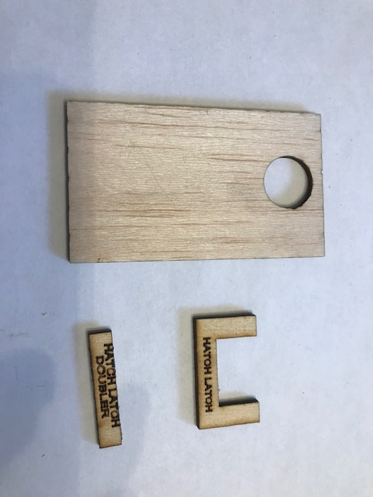
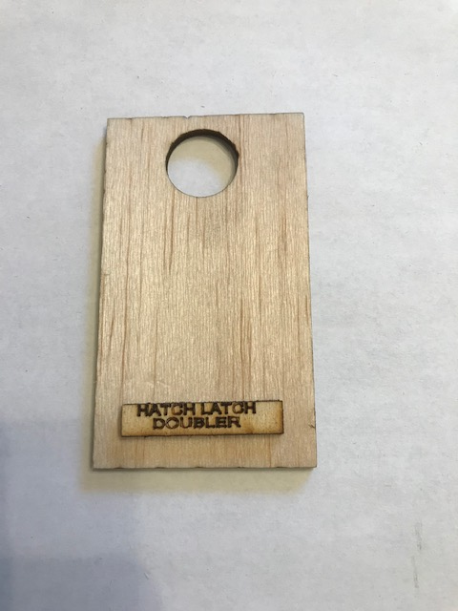
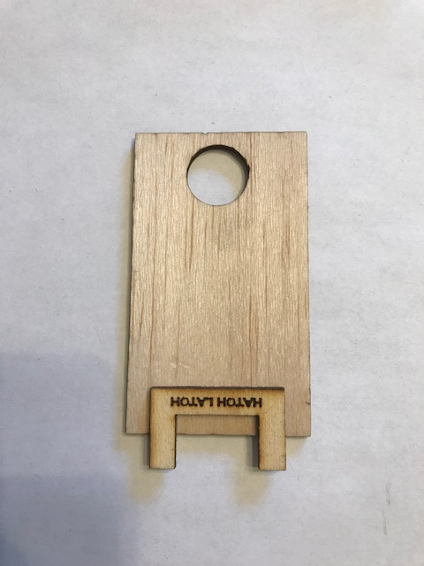
Hatch and Hatch Latch
Using Medium CA glue the Hatch Latch Doubler ¼” from the bottom of the latch and make sure its even on
Both sides as shown. Once that is dry, using medium CA again glue the latch in place as shown.
You will need to use magnets on the front
Of the hatch to keep it secure.

Slide 27
Trailing Edges
Locate the two 1/16” x 1” wide balsa strips, test fit them to the trailing edges. Once you’re happy with the fit, use Medium CA and put a thin line on each rib then carefully place the strips in place and hold until they are secure.
The top left side is shown here. The other three pieces
will mount in similar fashion.

Slide 28
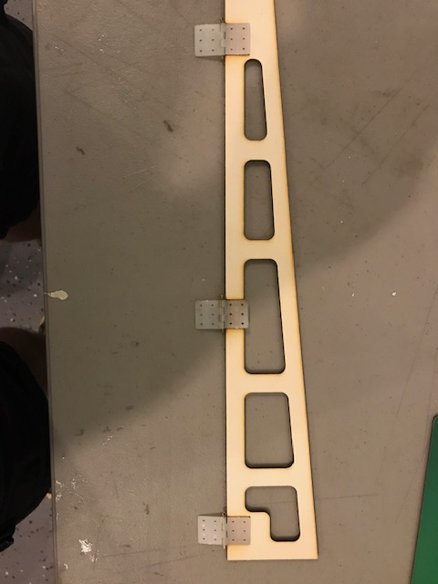
Ailerons
Locate the 4 parts of the Ailerons and control horns. Mark the 4 holes from the control horn on each aileron and using a small drill make 4 holes to mount the control horns later on in the assembly. Make sure you line up the 1/8” and 1/16” thick ailerons and line them up before drilling the holes.
Please see picture for reference.
Control horn
Will mount in this
Corner.

Slide 29
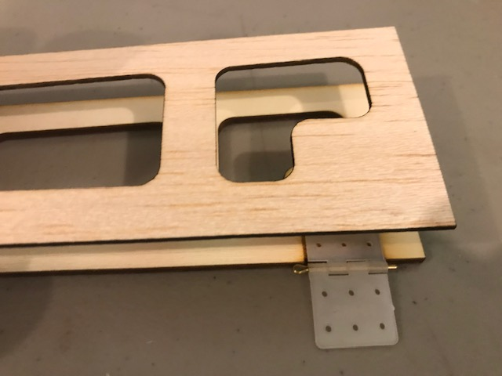
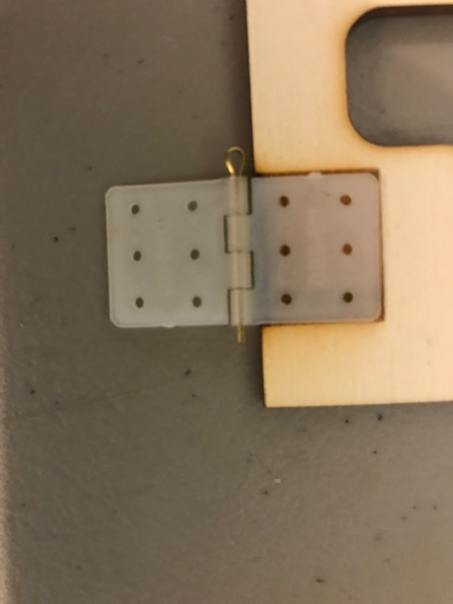
Ailerons
With the Aileron parts on your worktable. The 1/8” plywood parts have 3 Laser etched spaces for the hinges. At this point you can use CA or Epoxy to secure the hinges in place. Always use lotion on the “bendy” part of the hinge so glue does not inhibit the movement.
When the hinges are in place put a thin layer of CA on the 1/8” part of the aileron and carefully place the 1/16” thick aileron on top of the other part as shown.
When the glue has dried you can sand a slight taper on the Ailerons and round the edges.
You will also need to sand an angle on front of the aileron, allowing it have enough motion.
Tip: If you use
a hand lotion
on the “bendy”
part of the hinge
it will keep the
hinge from
Freezing up

Slide 30
Ailerons
Once the glue has dried on the hinges, mark the fuselage on the plane where the hinges will mount and cut a slot in the airframe to accept the hinges.
We will use these slots after the plane has been covered.

Slide 31
Covering
At this point you can begin covering the model. The Airframe, Fins, Servo hatch and the Ailerons all need to be covered.

Slide 32
Assembly
Once you have everything covered, begin with the Ailerons and mount the servo horns.
Note: I always use hand lotion on my hinges to protect them from any CA that might leak onto them.

Slide 33
Assembly
Vertical Fins
Test fit the vertical fins in the slots in the wing. They should fit snuggly into the slots.
Once you test fit them use medium CA to glue them in place. Use a square to make
Sure they are sitting straight in the slots.

Slide 34
Center of Gravity
On a wing this is VERY important. I have found that the sweet spot for this wing is about1/4” to 3/8”
in back of the main spar.
This will depend on the battery, motor and ESC you choose.

Slide 35
Once you install the motor, ESC and hookup the servos you will need to set the throws for the Ailerons.
Many people make a huge mistake here. You will only need approx. ½” to 5/8” throws.
Any more than that and the wing in almost uncontrollable.
We suggest setting high and lows rates. Set the low rates to 3/8 to ½” throw with 75% expo
High rates to ½” to 5/8” with 85% expo.
Start on low rates for the first flight and go from there.
Also hold the wing looking from the back and make sure the ailerons are not too far up or down.
They should follow the shape of the wing., If they are too far up the wing will do loops, too far down, well
… that wont be good.

Slide 36
First flight:
Have someone hold the wing and you man (or woman) the controls.
Get the motor turning at about ½ or ¾ throttle and gently up on
the elevators. Then have them throw the wing at about a 45 degree
angle upwards.
From there its all up to you.
If you have an accident with your wing, don’t worry, we will supply
Replacements parts for you to rebuild. If you pay the shipping, we will
Help you get the wing back in the air.

Slide 37
Have fun! Send us some pictures of your wing when its done, we
will post them on the web site.
Thank you for your purchase1 Please come back and see us again!!

